Slide 1
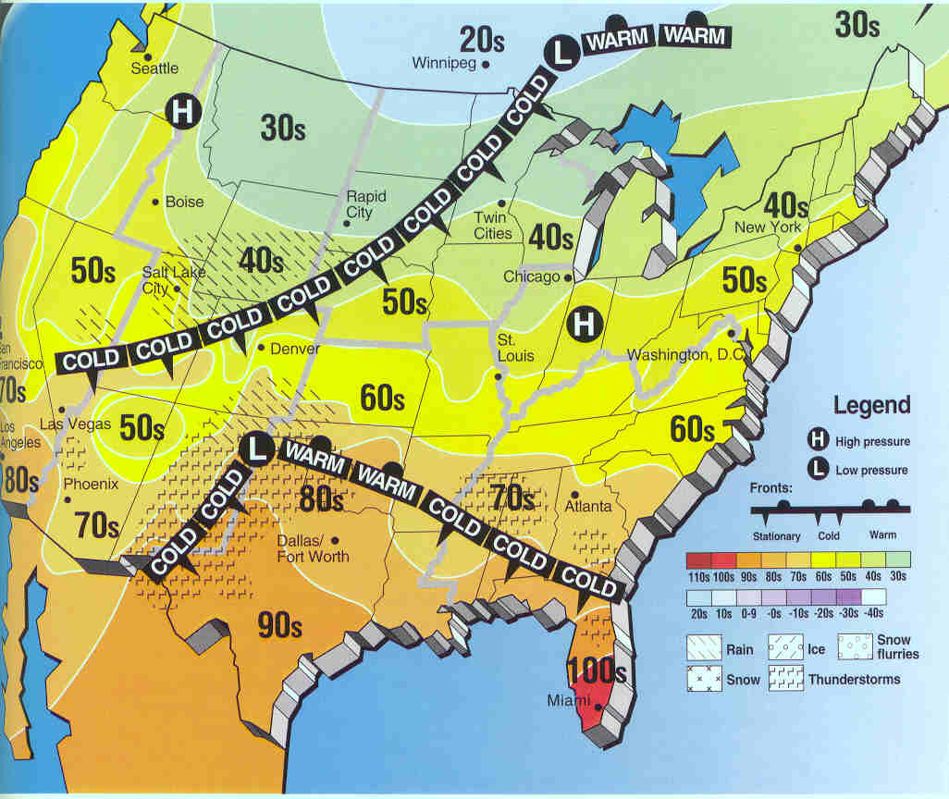
Do Now: Pretend you are a meteorologist. Write down today’s forecast.
Write down tonight’s HW:
Weather Map- complete sentences

Slide 2
Air Masses and Fronts
How do they affect weather?

Slide 3
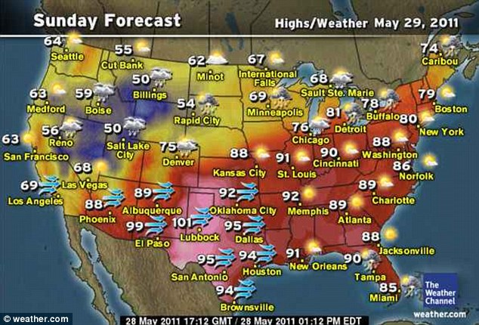
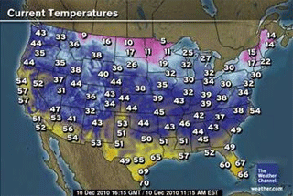
-Which states/regions do you think of as getting a lot of rain? Which states/regions do you think of as being dry?
-What’s the difference between states that are next to water and those that are inland?
-What time of the year do you think these maps are from? How do you know?
-What states look the same in both maps?
-Which states look different in each map?
-Which states/regions do you think of as being warm/temperate?
-Which states/regions do you think of as getting really cold?

Slide 4
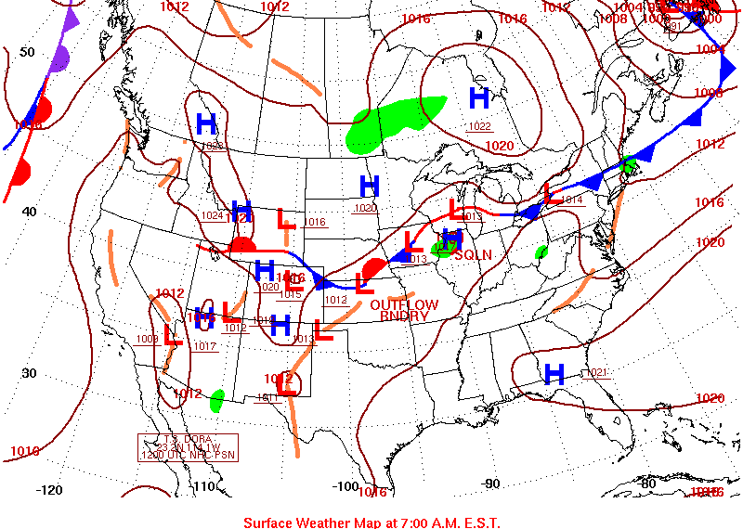
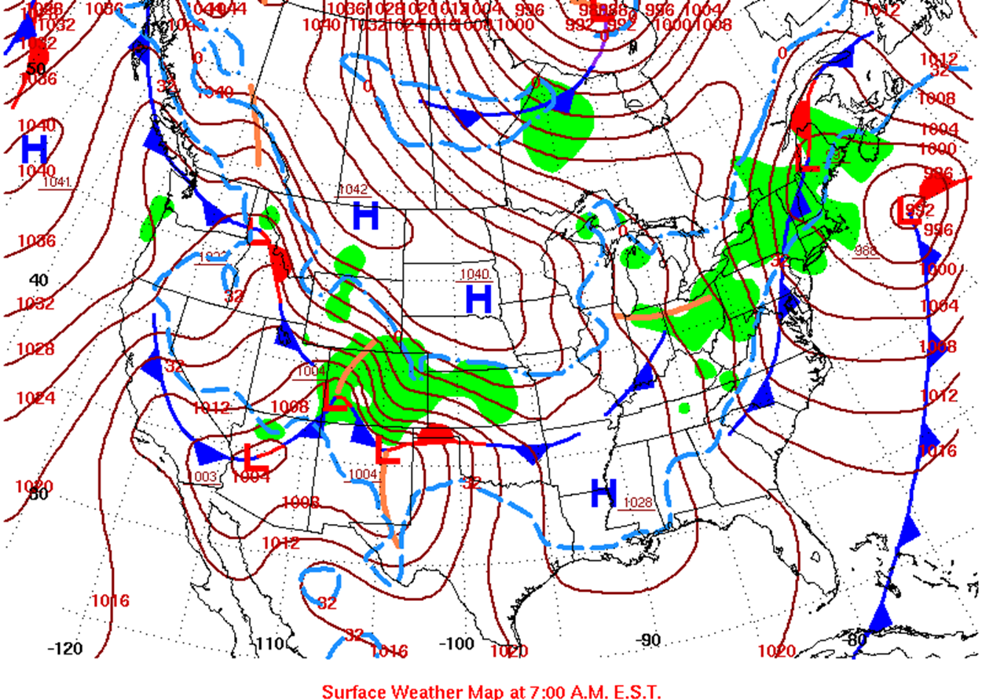
-What symbols do you recognize?
-What do those symbols mean? How do you know?
-What’s the difference between these two maps?
-What do the red and blue lines mean?
-What do you think the H’s and L’s mean?

Slide 5
Air Masses
Someone once said, “If you don’t like the weather in Texas, wait a minute, it will change!” Changes in weather are caused by the movement of air masses. An air mass is a large body of air that has the same temperature and moisture throughout.

Slide 6
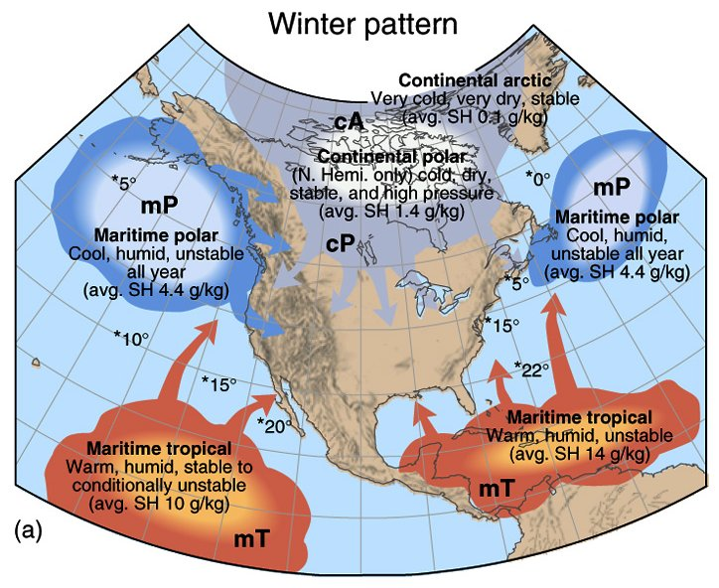
Where do air masses get their characteristics?
The moisture and temperature of an air mass comes from the area over which it forms
C= continental, forms over continents
M=Maritime, forms over water
P= Polar, forms over polar regions
T= Tropical, forms over tropical regions.

Slide 7
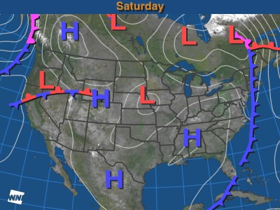
FRONTS
Air masses that form from different areas often do not mix. The reason is that there are different densities between the air mass. Less dense warm air will generally rise over denser cold air. The area where two different air masses meet is called a front.
There are 4 types of fronts:
-cold
-warm
-stationary
-occluded

Slide 8
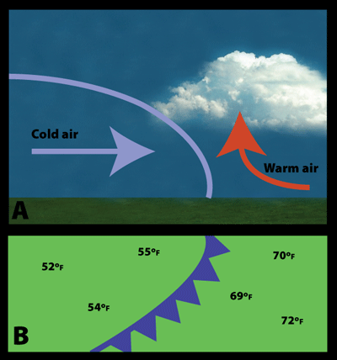
Cold Front
Dense cold air
rapidly replaces
warm air.
Triangles point to
direction front is
moving.
Bring low pressure, showers, thunderstorms.

Slide 9
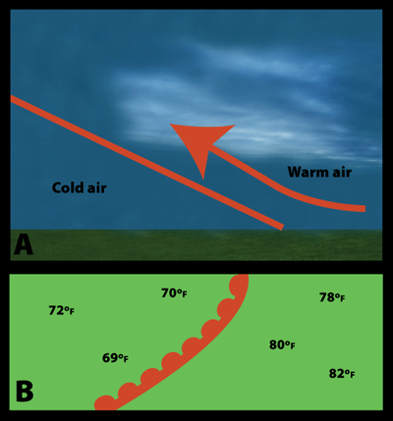
Warm Front
Slower moving
Brings rainfall &
fog.
Once front
passes, skies
clear & weather becomes warmer.

Slide 10
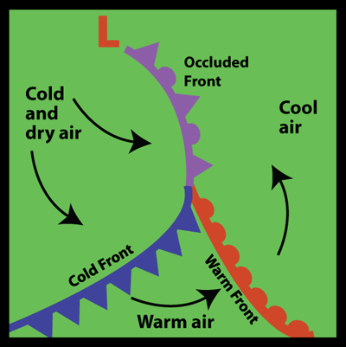
Occluded Front
Warm air pushed
above surface by
cooler air (cold
front) closing in
from both sides.
Brings thunder & drying.

Slide 11
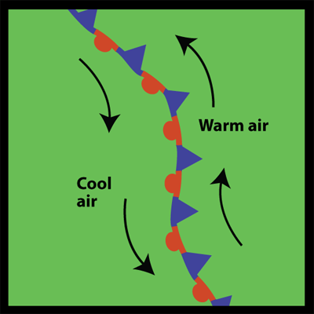
Stationary Front
Boundaries
between air
masses that are
not moving.
Usually brings clouds
& precipitation.

